Slide 1
AI-Assisted Development for Modern PAS Application Prototyping
Caroline Haslam ISO 22301 Program Lead
Internal use only
June 2026

Slide 2
Introduction
The purpose of this awareness is to provide you with an overview
of ISO22301 Business Continuity Program and the status of the Business Continuity
Management System in the India Region over the last year.

Slide 3
Business Continuity
ISO22301 is the international standard for Business Continuity.
Business Continuity enables us to respond and recover from incidents with the least disruption to our business.
There can be many types of incidents that happen; it is impossible to predict every type of scenario that could occur and
the subsequent actions to take.
However, by defining a structured set of basic guidelines, it provides a consistent baseline for responding to any type of
crisis.
Cyber
attacks
Civil
unrest
Natural
disasters
Supplier
disruptions
Malicious
intent
Fire
Service
disruption
Terrorist
incident
Power
outages
Pandemic

Slide 4
Business Continuity Management System
Emergency Response Plan (ERP) - Building evacuation guidelines
Crisis Response Team (CRT) – consists of Crisis Leader, Crisis Coordinator, Managers and Subject Matter Experts that manage an incident
Crisis Management Plan (CMP) – activation guidelines and process steps for the Crisis Response Team
Business Continuity Plan (BCP) – plan to guide us to respond, recover and restore from an incident
Business Impact Analysis (BIA) – document that analysis the impact over a period of time disruptions to our teams
  The Business
  Continuity
  Management
  System (BCMS)
  consists of:
Tabletop Exercise – chance for our CRT to come together and test our plans, procedures and identify any continual improvement opportunity
Risk Assessment – risks that affect our buildings, people and services
Business Continuity Policy – guideline of the BCMS
Improvement Log – tracking of continual improvement in the BCMS from incidents, testing, audits, meetings etc.,

Slide 5
Process Steps
  To manage an incident the Crisis Response Team, follow a number of steps, this provides us with a consistent baseline to manage an incident.
Activate
On the instruction of the Crisis Leader or alternative, the Crisis Coordinator notifies CRT members by phone, email or Teams to join a Teams call
Step 1
Using the event report template (located in BCP), Crisis Leader to assess the situation, impact to employees, infrastructure and operations
Step 2
Determine and initiate actions
Step 3
Communicate, determine what internal and external communications are required
Define & Assess Situation
Determine & Initiate Actions
Communicate
Monitor & Report
Step 6
Lessons learnt exercise
Step 5
Return to normal checks
Step 4
Monitor and report by holding regular reviews to repeat assessment and actions until incident can be closed

Slide 6

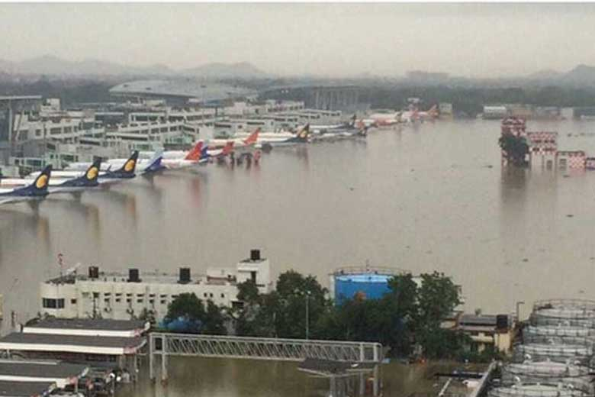
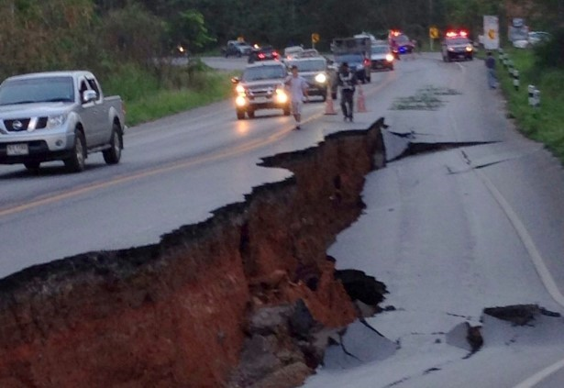


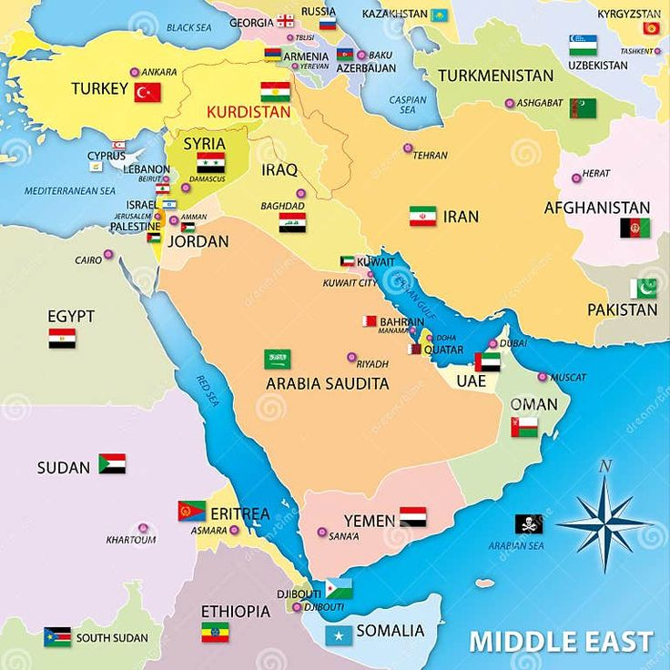



Cyclone Alfred, Brisbane 2025
Earthquake, Thailand 2025
India Region
Business Continuity
Management System
Chennai
Floods, 2023
Conflict, Middle East 2025
2020 Global
Pandemic
Ransomware Attack
2024
Blackouts
Spain 2025
Oman Terrorist Incident, 2024

Slide 7
Who and how
  The India Region Crisis Response Team (CRT) led by Shyamsundar Jagadeesan and Chandrasekar Sankaran who will
  manage an incident in the region, utilising the India Crisis Management Plan and Business Continuity Plan as needed.
  The scope of the CRT is to:-
    Manage the incident
    Ensure the safety of people
    Invite extended team (SME’s etc.) to assist with the incident/event
    Liaise with Senior Leadership
    Internal and external communication
    Assist the delivery and support teams to continue providing service to its customers

Slide 8
India Crisis Response Team
Role | Name | Role | Name
Crisis Leader | Shyamsundar Jagadeesan | Program Manager | Syed Shajahan
Alt. Crisis Leader | Chandrasekar Sankaran | Program Manager | Krishnan Moorthy
Crisis Coordinator | Sonu Mathur | Security | Joerg Kirsten
Alt. Crisis Coordinator | Abhishek Kumar | HR | Annis Banu Shanavaz Khan
Alt. Crisis Coordinator | Inder Jeet Singh | Communication | Radhika Natraj
Engagements Delivery Manager | Chittaranjan Mohanty | Facilities | Sarfuddin A
Technical Coordinator | Harinam Prasad | Finance | Sachin Upadhyay
Program Manager | Senthilnathan Ranganathan | Supply Chain | Akshay P
Program Manager | Suresh Babu
Crisis Management Plan is the document that guides the Crisis Response Team on activation and managing an incident.

Slide 9
Business Impact Analysis
Business Impact Analysis (BIA) - document that analysis the impact over a period of time disruptions to our teams, this information is then used to create the Business Continuity Plan (BCP). Example of what a BIA looks like:
Using scoring of 0 (no impact) to 6 (catastrophic) we rate:
what is the impact to the team if we had loss of staff member,
loss of site, loss of comms, loss of equipment, and what complete loss of service
would mean to Dedalus, and we rate this over a period of time, 4 hours, 8 hours, 1 day, 7 days and 28 days.
Scoring then gives us impact rating which then help determines criticality and prioritisation on the next slide.
Each individual team is listed, details include
what the team does
location of employees
delivery manager
Business process or activity | Location where this is conducted | Delivery Manager | What is the impact on Dedalus If the business process or activity is suspended? Impact and types to consider: - Loss of staff member, - Loss of site, - Loss of comms, - Loss of equipment |  | Level 1 | Level 2 | Level 3 | Level 4 | Level 5 | Total | Impact Rating
 |  |  |  |  | Quantify the impact if this business process or activity is suspended for periods up to:-
 |  |  |  |  | Up to 4 hours | Up to 8 hours | Up to 1 day | Up to 7 days | Up to 28 days | Total Score | High / Medium / Low
Team name | Noida - hybrid working | Managers name | Loss of staff member | Minimal impact, other members of the team would continue to provide the service. | 0 | 0 | 0 | 3 | 5 | 8 | low
 |  |  | Loss of site | Minimal impact, team can work from home/alternative site or could go into the office where possible. | 0 | 0 | 0 | 2 | 4 | 6 | low
 |  |  | Loss of comms | Minimal impact, work from an office/alternative location or utilise mobile phone for internet connection. | 1 | 1 | 1 | 4 | 6 | 13 | Medium
 |  |  | Loss of equipment (laptop etc) | High impact, email, teams can be accessed from personal device. Replacement laptops would need to be sourced. Team are hybrid working not all team in the office, could utilise other team members. If loss of laptop can use personal PCs to connect via virtual machine to Denmark, India DC. If loss of virtual machine connection would be high impact, if 1 person loss of connection can use other team members, high impact if whole team lost connection. Testing purposes only can use company mobiles phones | 3 | 4 | 4 | 6 | 6 | 23 | High
 |  |  | Complete loss of service | No one from Offshore can connect to the system, perform any job on R&D, do development, provide build, work on planned release work etc | 3 | 4 | 4 | 6 | 6 | 23 | High

Slide 10

Business Impact Analysis
Would lack of service affect our Legal Regulatory requirements? | Would lack of service affect legal contractual requirements? | Critical Service | Criticality level | Prioritization Level
Yes or No | Yes or No | Yes or No | Company, Regional, Recover as needed | 1 - Very High 2-High, 3 - Med. 4 - Low
No | No | Yes | Regional critical | 2
During an incident,
prioritisation levels show
which teams recovered first
1 first then 2, 3 and 4
If the team is unable to
provide their service
does it impact
any country
laws or regulations?
If the team is unable to
provide their service
does it impact any
contractual obligations?
Is the service critical?
Criticality level
The minimum requirements for the team during a disruption -
Minimum team members
Minimum equipment
Recovery Time Objective (RTO) | Maximum Allowable Outage (MTPD) | Minimum service level (MBCO) (minimum requirements staff, tools - laptop, detail any cross skill, detail any backup support)
4 hours | 1 day | 2 developers and 2 testers to be available Tools/dependencies; laptop, internet, VPN
During a disruption
the time the team
need to be
up and running for e.g.,
meet an SLA
Maximum time
the team can be
unavailable for

Slide 11
Business Impact Analysis
In the BIA we list what our teams are dependent upon:
Internal dependencies (other teams within Dedalus) | Technology (description of what the technology is, does everyone have access. Assume PC/laptop, network connectivity, phone, MS Office, Notes) | Data / Documentation (description of what data/documentation is, what is it used for, and location i.e. SharePoint or Teams pages, who has access, can it be accessed on phone?) | Equipment (transport, spare parts, 3G cards, tool kits) | Suppliers (Name, service provided, backup contingency, supplier resiliency)
Jira Team IT Team Global | ServiceNow - internal tickets - full team access Jira - development - full team access Zscaler - external access - full team access | SharePoint - documentation - full team access Confluence - team documentation - full team access | None | None
Technology / applications
dependent upon,
used for and who has access
Equipment dependencies
What teams
in Dedalus dependent upon
Where team
documentation is stored and
who has access
Supplier dependencies,
what the supplier does and if we
lost the supplier what are our contingencies

Slide 12
Tabletop Exercise
As part of the Business Continuity Program, each year we are required by the ISO22301 standard to test our Business
Continuity Plan, we call this a tabletop exercise. This enables our Crisis Response Team to get together
and talk through what they would do in certain situation and check everyone is aware of their roles and responsibilities.
Every incident is different, but by doing tabletop exercise we can practice, so during a real incident we know the steps
that we need to take.

Slide 13

Tabletop Exercise
This year our tabletop exercise for the India Region was on the 20th March 2026, scenario was ransomware attack, as a team we discussed:
How the Crisis Leader is notified of the incident
How the Crisis Team form
Roles and responsibilities
Process steps for the team
Priorities for the team
How technically the situation would be handled
Impacts and disruptions
How do we continue to provide a service?
Communications
How the Crisis Team handle the situation until the situation is resolved
The exercise consists of all the invitee's sharing views on how the situation should be handled within their area of expertise.

Slide 14
Objectives
Part of the Business Continuity Management System, we have a number of objectives for the region these are:
Objective | Progress | Status
To protect Dedalus, its staff, our customers and other stakeholders from unforeseen incidents and disruptions to our business operations – We meet the objective by maintaining Business Continuity Plan and validate through testing | Annual review of the BCP was completed in May 26 and our BCP exercise was March 26
Perform an annual review of the Business Impact Analysis, identifying critical business operations, dependencies and analysis of what a disruption to the region would mean | Annual review of our BIA was completed May 26
Identify any potential business continuity risks, assess and treat accordingly | Annual review of our risk assessment was conducted January 26
To ensure Dedalus is able to meet its legal and regulatory obligations | Annual review of our legislations completed January 26
Take into account applicable requirements (Internal and external issues, needs and interests interested parties, legal and regulatory requirements) | Issues reviewed during management reviews Interested parties managed by IMS Manager Regulatory review complete for 2026
To ensure India BCMS meets the requirements of the ISO22301:2019 standard | Internal audits booked for July 26, and complete for 25
Annual training for Business Continuity with a completion rate of 90%+ | Annual 2025 training complete
Out of date | In-progress | Complete

Slide 15
Risk Assessment
As part of the ISO22301 Program we also complete risk assessments about our buildings, people and services.
Building risks such as fire, flooding, loss of power, security, loss of internet.
Natural risks such as earthquakes, hurricanes, tsunami, climate risks such as flooding.
Not having enough spare laptops during an incident.
Threat to safety from other countries.
Service risks are managed by each times own risk registers or escalation paths.

Slide 16
Documentation
  Reminder all ISO documents located in – Interfacing-EPC.
  Training and information on Interfacing can be found IMS and Interfacing (end user training) but if you would like further
  overview and training reach out to Caroline Haslam and happy to guide you through interfacing.
  Documentation for the India Business Continuity Management System, can be found 02 – Procedure this includes key
  documents:
  Crisis Response Roster (CRT) BC-LIN-WI-001 CRT Roster India.xls
  Crisis Management Plan (CMP) BC-LIN-WD-001 Crisis Management Plan India Region.doc
  Business Continuity Plan (BCP) BC-LIN-PR-001 BCP India.doc
  Business Impact Analysis (BIA) BC-LIN-WI-011 BIA India Region.xls
  Next to each document is 2 icons one for downloading a document or quick view.
  Everyone has read access on published documents.
  Business Continuity Policy BC-G-PO-001 Business Continuity Policy.docx in 2025 non-compliance examples added to the policy, also includes implications of nonconforming to the BCMS requirements.

Slide 17
Continual Improvement
  Continual improvement within the BCMS is one area we are always working on, and this ensures the BCMS stays
  effective and improved performance. In 2025 BCMS a new Improvement Log was developed; this tracks continual improvement from:
  BCP tabletop exercises
  Internal and external audits
  Management reviews
  Employee recommendations and other interested parties
  Updates in the standard
  Incidents and return to normal activities
  The improvement log tracks improvements noted for the region and if they can benefit other regions BCMS. Some improvements in the last year for India region BCMS:
  New improvement log
  Updated BCP and BIA plans to include support teams and working locations
  Workday communications reminders
  Annual BC training to include details on after a disruption
  BCP tabletop exercise on ransomware
  CRT members training on Crisis Management Plan during BCP tabletop exercise
  Team risk registers verified
  BCP escalation path to Senior Leadership added

Slide 18
Audits
  To ensure we meet the requirements of the ISO22301 Standard we must go through internal and external audits, Chennai
  office has gone through internal audit in the last 12 months, Noida internal audit booked for July 26. Findings included:
  Internal Audit
  1 Minor NC
  Annual training does not cover responsibilities after disruption
  4 Opportunity for Improvement:
  Internal and external issues categories not document in BCMS Manual
  NCs should be submitted and reported in Jira system
  BCMS improvement log identifies improvement but not improvement on NCs
  Spare laptops , no risk on do we have enough during adverse event
  All our audit findings are completed and tracked through our
  Management review meetings.
Level | Description
Major nonconformance | A complete breakdown in the management system; no evidence of management commitment to support the defined management system; no process defined or followed as required by the relevant standard
nonconformance | A departure from the established procedure which will adversely affect the intended purpose of the procedure Repeated minor findings indicating that the management system is not working effectively Inadequate implementation of a procedure
Opportunity for Improvement | Recommended action would bring products and/or services to a higher level of security, quality, and/or maturity.

Slide 19
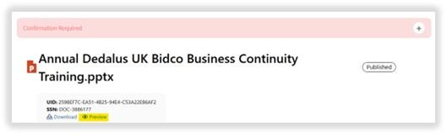
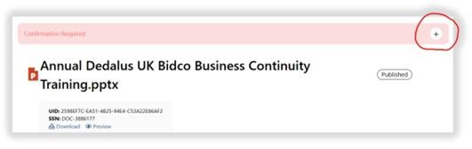
Annual Business Continuity Training
  Business Continuity annual training to be issued in June/July 2026, via Interfacing-EPC tool.
  Provides an overview of Business Continuity Management System.
  PowerPoint presentation and will take about 15 minutes to read through.
  Need 90%+ completion rate, will receive email reminder until you have confirmed completion.
  Any issues contact Caroline Haslam
Confirmation: | Nov 5, 2025, 7:11:04 AM
Document: | Annual Dedalus UK Bidco Business Continuity Training.pptx [V 2.0600]
Sent by: | Michael Markarian (michael.markarian)
Environment: | Dedalus
Due date: | Dec 5, 2025
Comment: | As part of the ISO certification program, all employees must take the annual refresher training provided in the (ISO 22301) Annual Dedalus UK Bidco Business Continuity Training. Please click on the Document link below to take you to the training. Please read through the content of the material and ensure you understand the content. You can access the training material via the "Preview" Function below the training title. Once you have completed the training, you will be required to confirm completion and understanding of the training in EPC. To do this please click the plus sign to the right of the “Confirmation Required” banner at the top and click on “Confirm” to mark course completion to receive credit. Please also ensure that when accessing documents via links in the training, the mode is set to “Published” in the top left corner of the screen located on the blue banner. If the indicator shows “Latest” click the white toggle button to change the mode. Training must be completed within 30 days. All employees are required to complete this training by Friday 12th of December 2025. If you have any questions or issues accessing the training, please contact the following who will assist you: Caroline Haslam or Michael Markarian.
Step 1 - will receive an email similar to this,
from Interfacing-EPC, click on the
link, this will take you into Interfacing.
Step 3 – to confirm completion, click on the plus sign on the right and click confirmed
Step 2 – click on preview so can read through training material

Slide 20
Cyclone Alfred, Brisbane 2025
Earthquake, Thailand 2025
Chennai
Floods, 2023
Dedalus
UK Bidco
ISO22301
Program
Conflict, Middle East 2025
2020 Global
Pandemic
Ransomware Attack
2024
Blackouts
Spain 2025
Oman Terrorist Incident, 2024

Slide 21
Program Update
  The ISO22301 Program is now implemented in the following regions throughout Dedalus UK Bidco:
  UKI Region – UK and Ireland (Leeds & Kildare)
  ANZ Region – Australia and New Zealand (Melbourne, Sydney, Brisbane and Wellington)
  NE&SA Region – Northern Central Europe and South Africa (Sweden, Netherlands, Denmark and Johannesburg)
  SE Region – Central Europe (La Rozas, Malaga, Seville, Lisbon and Leon)
  India Region – Chennai and Noida
  In the last year we have had no incidents in which the Crisis Response Team invoked.

Slide 22
Role you Play
Everyone has a role to play in Business Continuity and its effectiveness:
  Know your site emergency response procedures and emergency exits if you are office based or a visiting a site
  Keep workday up-to-date with your contact and emergency contact information
  Take your annual ISO22301 and ISO27001 training
  If an adverse event happens, remember:
    Stay calm
    Stay safe
    Follow guidelines from government agencies, emergency services and warning systems
    Only when it is safe to do so, reach out to your manager and let them know you are safe and your current situation (if possible, within 48 hours)
  Keep at home battery operated radio and spare batteries, when facing loss of power/communications this may enable you to follow any guidelines from local government and warning systems.
  Incidents can be traumatic and may have a lasting impact on your well-being. If you are feeling overwhelmed or distressed, seek support from friends, family, or mental health professionals. Talking about the incident and processing your emotions can help you cope with the situation.

Slide 23
Thank you

